Slide 1

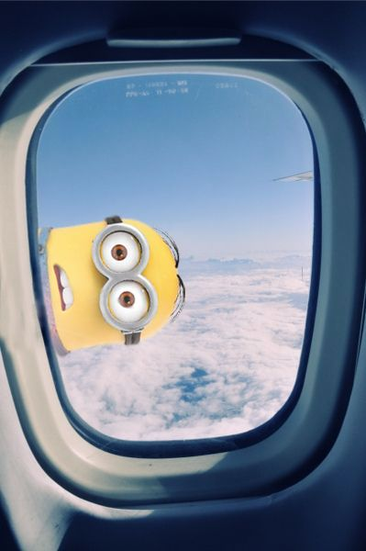
AIR TICKET BOOKING SYSTEM

Slide 2

INTRODUCTION
Airline reservation system incorporates fare tariffs, passenger reservations and ticket
records.

Slide 3
SOFTWARE REQUIREMENT
64-bit Linux Operating System.
GNU compiler

Slide 4
ALGORITHM
Start
Add the passenger info and book the seat
Calculate fare
My ticket
Destination and source
Stop

Slide 5
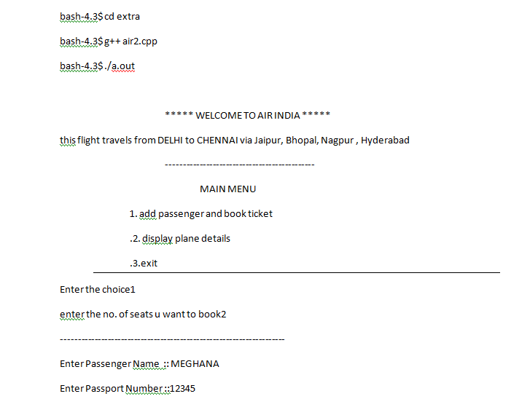

OUTPUT

Slide 6
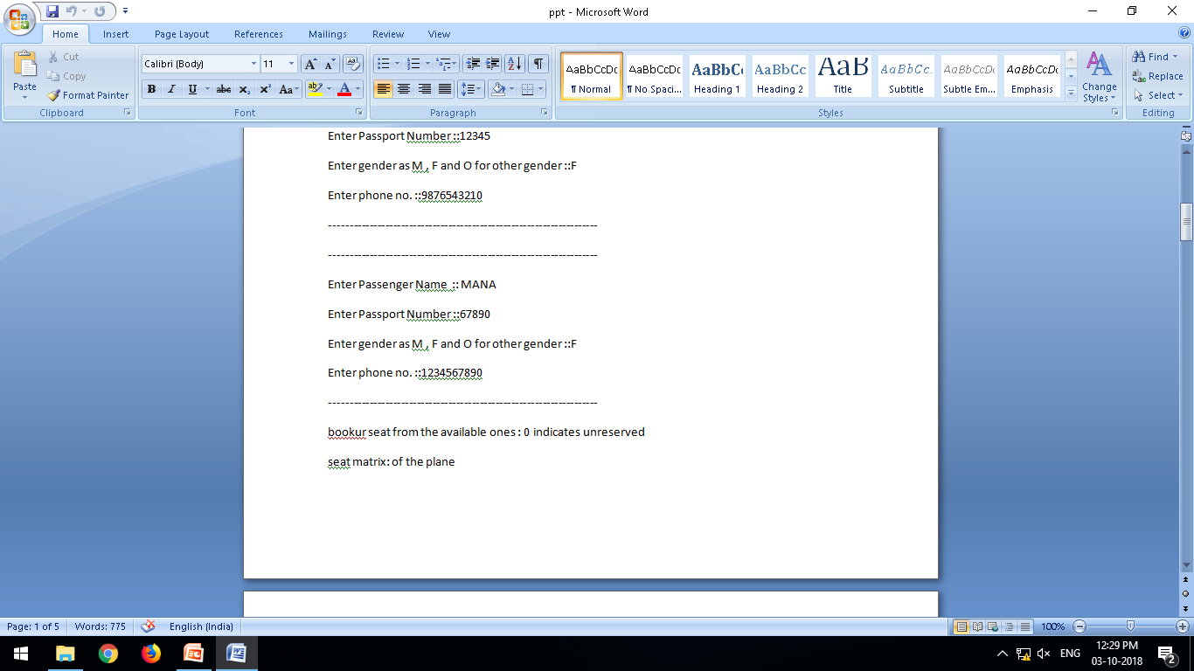

Slide 7
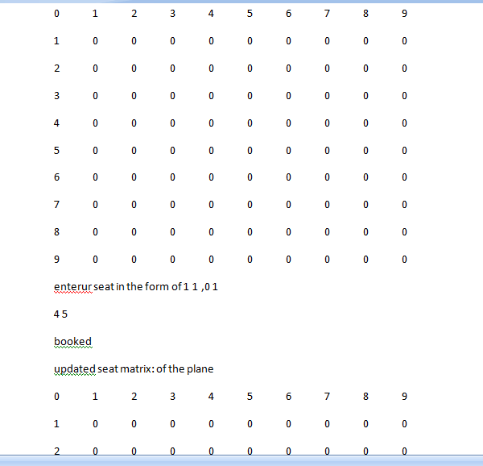

Slide 8
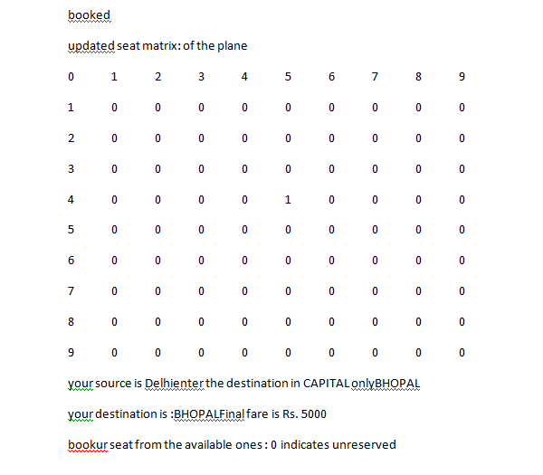

Slide 9
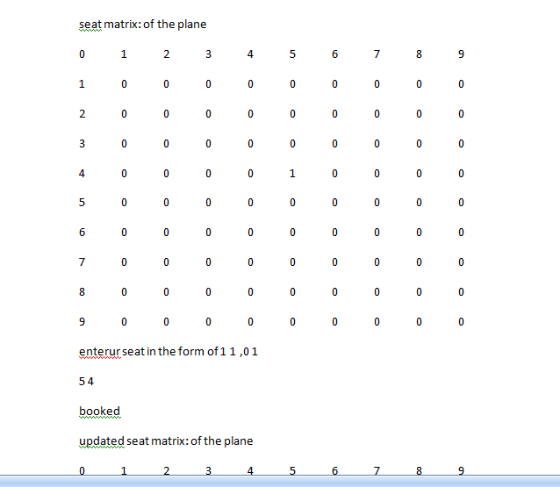

Slide 10
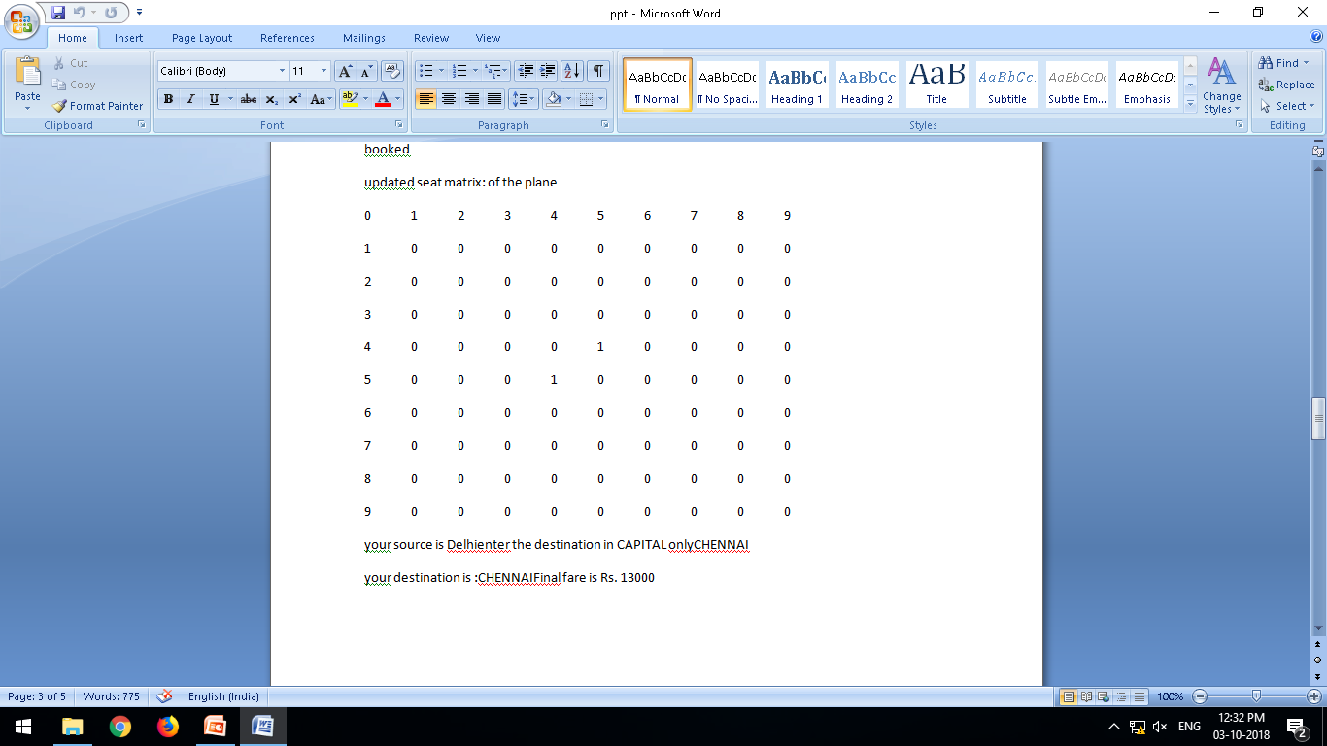

Slide 11
CONCLUSION
Successfully implemented airline reservation system using file handling and concepts of OOP in C++ language.

Slide 12

Presented by :Meghana Manali Ajay

